Slide 1
Mental health in forced migration: development and adaptation
MENTAL HEALTH, REFUGEES, AND MIGRATION
Athens, Greece, 24th May 2018
Bojan Šošić
Board for Psychiatric and Neurological Research,
Department of Medical Sciences,
Academy of Sciences and Arts of Bosnia and Herzegovina

Slide 2
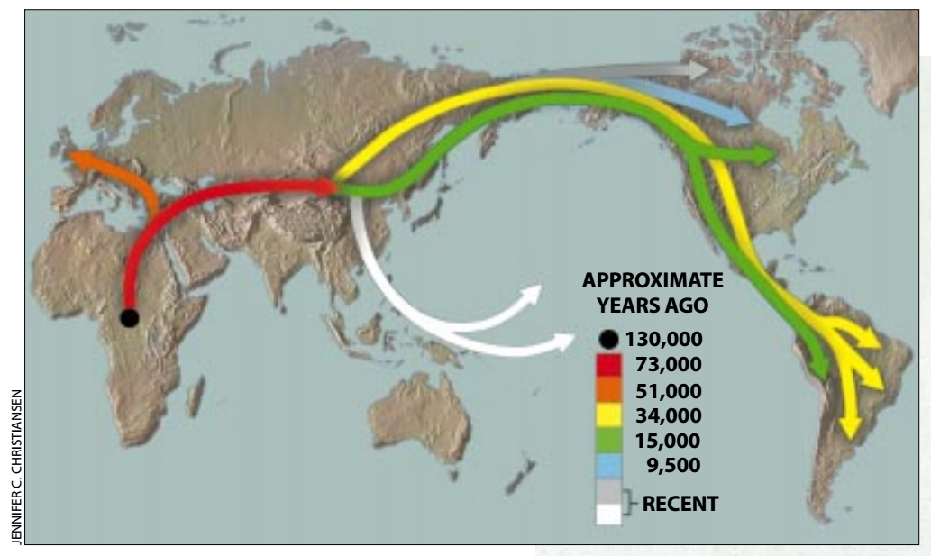
Mankind in brief
Wallace, 1997

Slide 3
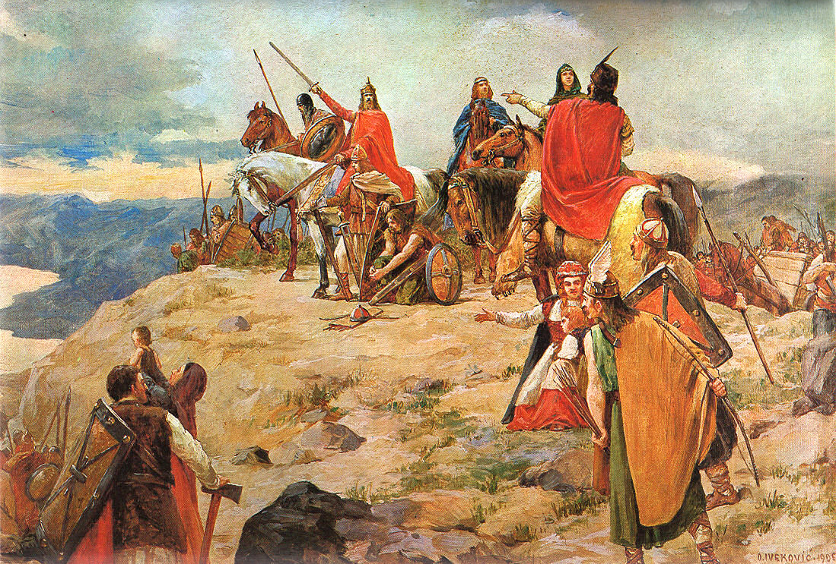
And what do I have to do with all that?
Šošić; one variant of the family names in former Yugoslavia stemming from Greek σωτήρ (sōtēr) – “savior, preserver”.
Oton Iveković, 1905 – Arrival of Croats to the Adriatic Sea

Slide 4
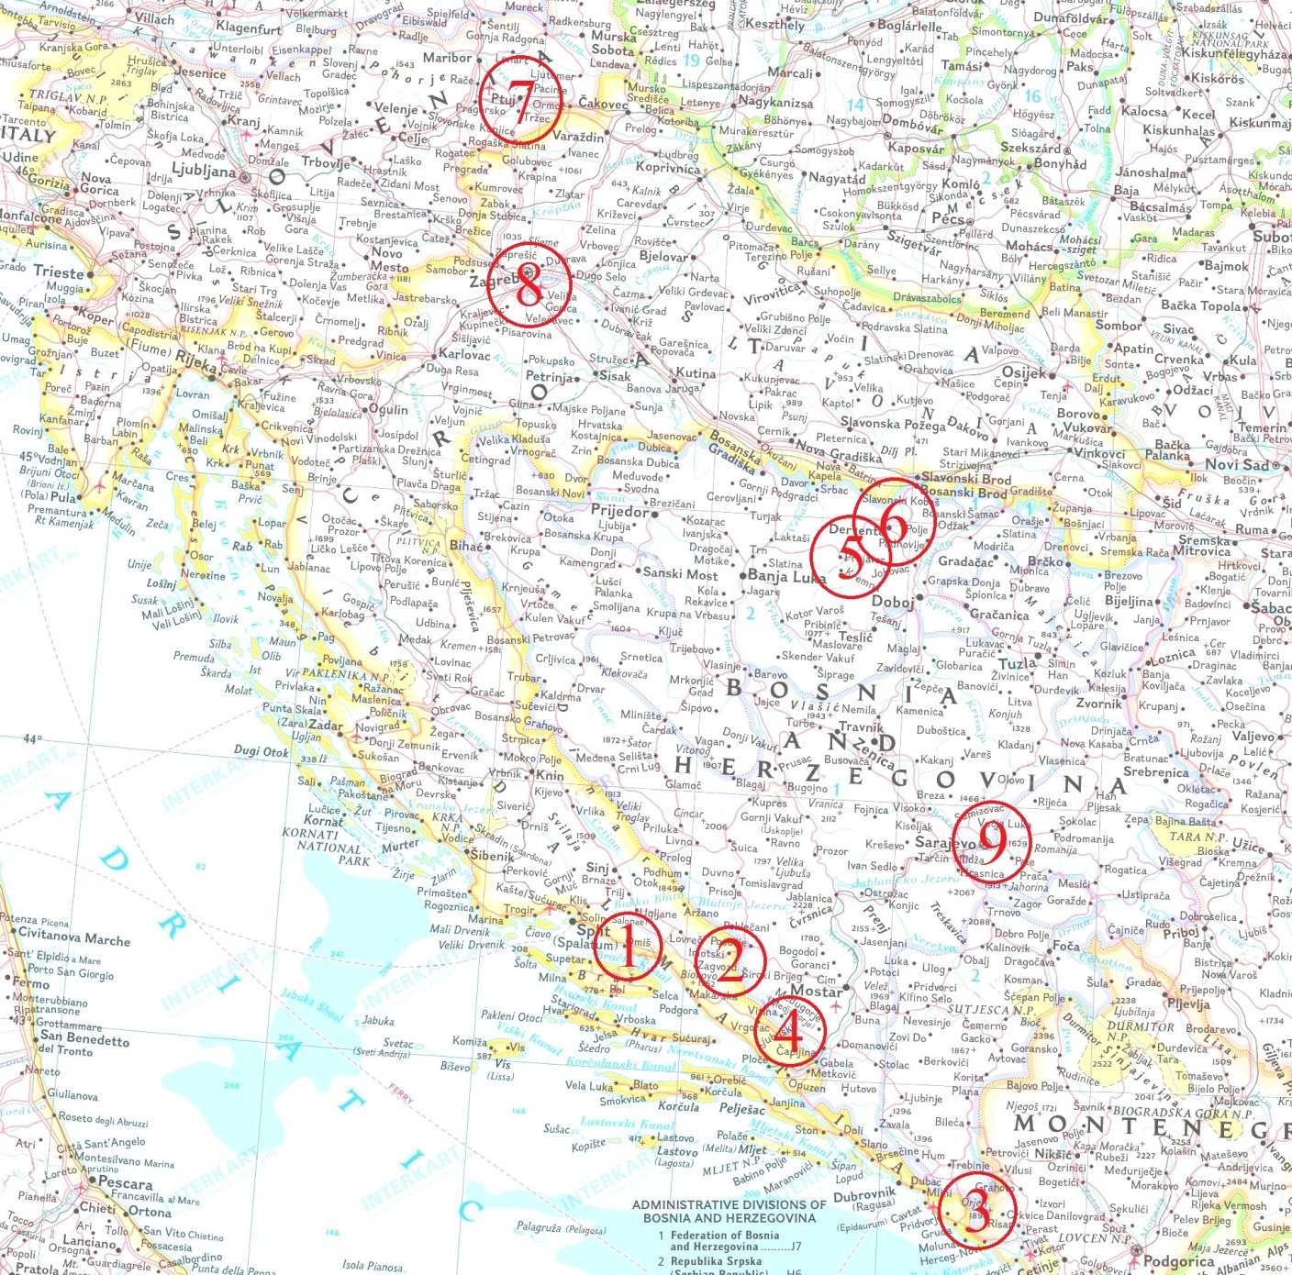
The Šošić
family
migration

Slide 5
Our accumulated impressions:
(Bosankic, Mesic & Sosic; in press)
Initial forms of providing aid just after the war (sometimes even during), were often provided disregarding the context and the actual needs of beneficiaries.
Donor agencies occasionally intentionally ignored contextual conditions and factors and thus potentially inflated the portrayal of the problem. - "I pay attention when I earn money, not so much when I spend it."
Over the two decades since the war, the donors did show a tendency to increase communication with the authorities and the target groups, i.e. refugees or (later) internally displaced persons as beneficiaries, either directly or through subcontracted implementing agencies in the field, which sometimes had the status of partners.

Slide 6
There has been an increase in providing forms of aid that were meant to be taken over by the Bosnian-Herzegovinian authorities as durable and self-sustainable solutions, and oriented towards concrete outcomes, although there were no mechanisms to ensure that actually happens.
Involvement of consultants in collecting data on the target groups is often constrained and even guided by the contracting agencies.
Migrants are often at an intersection of aid provision by various donors.
Migrants do invariably realise the assistance they receive is contingent on their poor living conditions.

Slide 7
With time passing since the war it becomes increasingly difficult to discern what kind of destiny would be typical of this group, compared to the general population. Identification with the group seems to have a primary role to justify its recipient role with the compatible and complementary role of the donor. A migrant is a migrant to an assistance provider, but to others, and increasingly with time, they may simply be colleagues, students, friends... As in the humorous definition of a sadist as a person who is kind to a masochist, donors and their beneficiaries apparently have a dynamic relationship of providing each other's raison d'etre.
Mental health - In instances we did encounter problems that could have been proved to be clinically relevant, these issues could typically be attributable to reasons equally probable in the general population (N.B. in Bosnia). WE NEED TO STOP PATHOLOGISING MIGRANTS.

Slide 8
"The floating pumpkin syndrome"

Slide 9
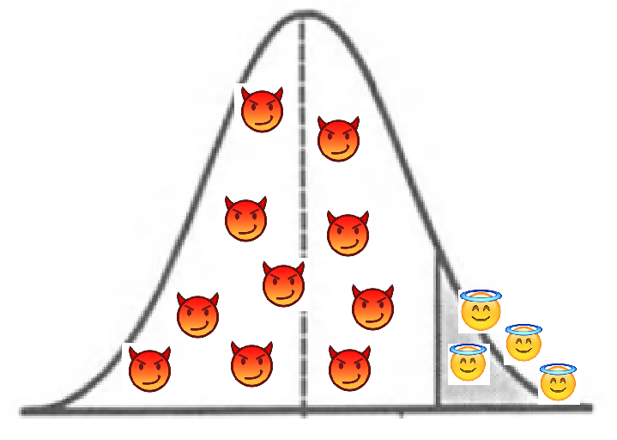
Relative deprivation and learned helplessness
The decision to migrate can have much to do with personal values, not only direct pressure or financial circumstances.

Slide 10
A final note
We amass data, but we do very little to understand.
We need more Maslow in our science on migration.

