Slide 1
Mental health as a determinant of Ukrainian immigrant families’ Adaptation Theoretical and pracitical perspective
Lidia Zabłocka - Żytka
Institute of Psychology
The Maria Grzegorzewska University (APS)
Warsaw, Poland

Slide 2
Mental health as a determinant of Ukrainian immigrant families’s adaptation. Theoretical and pracitical perspective
The Children/ Indivudual and family development
Migration as a stress factor
Ukrainian immigrant families’ adaptation problems in Poland- examples
Psychological support as a mental health support
Notes:
agenda

Slide 3
The Children/ Individual and family development
A

Slide 4
The Children/ Individual and family development
We couldn’t talk about children without family context;
Children develope, as well as family;
Every stage of developement is conected with different tasks and needs;
Development over life course involves adaptaion to the normative and non- normative events
There are many detreminants of developent: individual (biological, psychological), social, cultural, economical, historiacal…

Slide 5
Stages of child development
The baby (0-1 year)
The toddler (1-3 years)
The pre school child (3-5years)
The school child (5-11 years)
The Adolescent (11-13 years)
Early adolescence (13-15 years)
Mid adolescence (15-18 years)
Late Adolescence (18 years)
Young adulthood
Havighurst (1981):
Toddler and early childhood(0–5/6 )
Mid childhood (5/6–12/13)
Adolescence(12/13–18)
Young adulthood (18–35 )

Slide 6
The Family Life Cycle (Stages of family development by Duvall)
Married couple without children
Childbearing families
Families with preschool children
Families with school children
Families with teenagers
Families that are launching
Empty nest families
Aging families
Notes:
lifecycle

Slide 7
Normative events in family development
Birth of a child
Death of family member
New school, job….
All these events require adaptation and can provoke psychological crisis/mental health problems.
Notes:
Pics?

Slide 8
Migration as a stress factor
B

Slide 9
Migration as a stress factor
Immigration is non-normative life transition
It requires adaptation
Notes:
Pic?

Slide 10
Migration as a stress factor
Carlos Sluzki’s framework for the stages of migration (Perreira, Ornelas, 2011):
The Pre-Migration stage
The Migration stage
The Post-Migration stage

Slide 11
Migration as a stress factor- Acculturative Stages (Berry, 1977)
Honeymoon phase;
Confrontation phase;
Separation phase (culutre shock);
Adaptation phase;
Biculturalism.
Notes:
These stages include:
1. Honeymoon phase, characterised by curiosity about place, culture and change,
a kind of excitement;
2. Confrontation phase, which involves a sense of confusion;
3. Separation phase - “culture shock”, when immigrants mainly experience anger and
frustration;
4. Adaptation phase, characterised by calm;
5. Biculturalism phase, which is the stage of creative and fruitful activity in a new culture.

Slide 12
Determinats of immigrant adapatation
Personal factors (developmental life stage…)
Contextual factors
(the socioeconomic status,
circumstances of migration,
immigrant family situation,
social support) (Levitt at al., 2003)
Notes:
Gaf

Slide 13
Ukrainian immigrant families’ adaptation problems in Poland
C

Slide 14
Ukrainian immigrant families’ adaptation problems in Poland-general information
Prevalence - more imigrants after 2014 in Poland
Two different groups
Migrants and their families after The World War II
Present economic Immigrants
Historical perspective

Slide 15
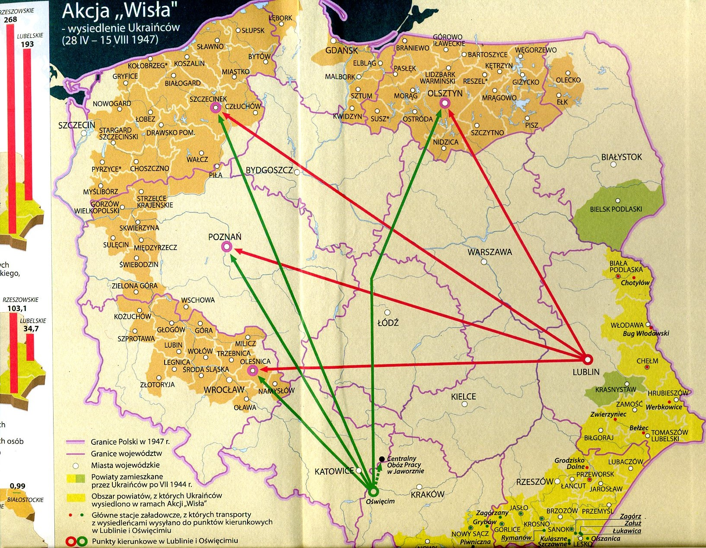
(Misiło, 2013)
Resettlement of Ukrainians in 1947

Slide 16
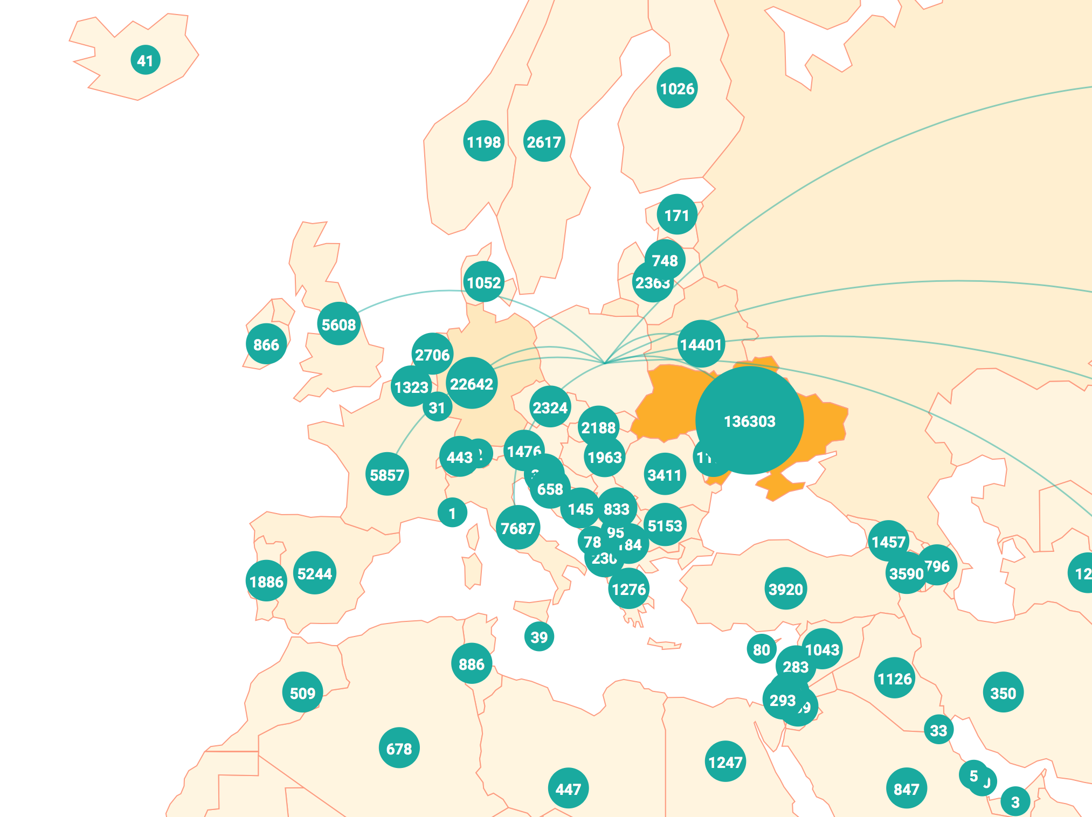
Migration to Poland in 2017

Slide 17
Ukrainian immigrant families’ adaptation problems in Poland-general information
Specificity of present Ukrainian immigration in Poland:
Economic/labour immigrants
Young women (till 2014)/ young men (now)
Well educated immigrants till 2014/less educated immigrants now
Poland - Ukraine (West/East Ukraine)
Long last economic immigration
In 2018 almost 2 milions economic immigrants

Slide 18
Ukrainian immigrant families’ adaptation problems in Poland-from psychological/clinical/practical perspective
Family breakedown
Parenting problems
Identity (national, cultural, personal)
Cultural differences, discrimination, stigma
Mental health problems
There are strong conections between all this problems
Notes:
Also educational problems

Slide 19
Psychological problems of Ukrainian immigrant families

Slide 20
Ukrainian immigrant families’ adaptation problems in Poland-from clinical/practical perspective
Family breakedown:
For children - lack of safety; attachement disorders
For adults – uncertainty; isolation; different social roles; lack of support (Kawczyńska- Butrym, 2008b; Becker Pestka, 2012)
Notes:
Also educational problems

Slide 21
Example #1
„I'm tired of work, because I work 10 hours a day. I have no will and energy to get up in the morning. I wake up at night and I can’t sleep. I'm afraid about my future. I worry about the situation in Ukraine. I have no place to return, and I don’t feel comfortable here, in Poland. I've got no one to talk about my problems. Everyone has his/her own business. Everyone expects me to do everything ... "
(Woman, 52 years old).

Slide 22
Ukrainian immigrant families’ adaptation problems in Poland-from clinical/practical perspective
Parenting problems:
Family members have no experience in spending time together
Family members ”don’t know” each other
Different expectations ( parents - grandparents- children)
Notes:
Also educational problems

Slide 23
Example #2
„For ten years I have been working in Poland. Last year my husband and my daughter moved to Poland. She is 13 years old. So far they have lived in Ukraine. Being honest, I can not communicate with them. I find them like strangers. I think they don’t understand me. My doughter doesn’t respect me. What should I do?”
(Woman, 32 years old)

Slide 24
Ukrainian immigrant families’ adaptation problems in Poland-from clinical/practical perspective
Identity
Different kinds/levels of identity: national, cultural, personal…
Process of developmens one’s identity
Adaptation to other culture - comparing and connection of values, rules (Gmaj, 2012; Piegat-Kaczmarzyk, Rejmer, 2010 ).
Notes:
Also educational problems

Slide 25
Example #3.
„I'm afraid my grandson will forget the Ukrainian language. He is 3 years old. In kindergarden he speaks Polish. At home we speak Ukrainian. Is it ok? Maybe we should speak only Polish? But what about his roots, our tradition?”
(Woman, 55 years old).

Slide 26
Ukrainian immigrant families’ adaptation problems in Poland-from clinical/practical perspective
Cultural differences, discrimination, stigma
The less cultural differences the better adaptation
Awareness of diffreneces (Cieślikowska, 2012)
Knowlege about new culture, experience of being in foreign countries
Discrimination, Stigma (lower self esteem of children) (Piegat-Kaczmarzyk, Rejmer, 2010)
Notes:
Also educational problems

Slide 27
Example #4.
"My son’s school mates are agressive and they don’t accept my son. They say he should go back to Ukraine. My son does not want to talk about it, but he also refuses to go to school! What to do? I think we will change school. Maybe in the other school children will be more torelant.”
(Man, 38 years old)

Slide 28
Mental health of Ukrainian immigrant families

Slide 29
Ukrainian immigrant families’ adaptation problems in Poland-from clinical/practical perspective
Mental health problems
higher rates of mental disorders such as: psychosis, mood disorders, anxiety disorders, and particularly posttraumatic stress disorder, compared with indigenous populations (Giacco, Matanov, Priebe, 2014; Laurence at al., 2011)
Children - important for their development
Adults - important for their parenting
Notes:
Also educational problems

Slide 30
Influence of mental health problems on children development

Slide 31
Psychological support
D

Slide 32
Psychological support
Psychological counceling
Psychotherapy
Mental health promotion
via
Trainings for parents
Trainings for educators, social workers, GPs, medical stuff (also psychologists)

Slide 33
Genaral Barriers in Access to mental healthcare
language barriers,
different beliefs,
explanatory models of mental illness,
confidentiality concerns, influence of stigma,
reluctance to seek help outside (Giacco, Matanov, Priebe, 2014);
feeling of sheme at being labelled mentaly ill.

Slide 34
Example of mental health promotion materials
http://www.entermentalhealth.net

Slide 35
Need of:
Research
Increasing the access to public health care/psychological help
Mental health promotion programs implementation

Slide 36
Thank you!
email: lzablocka@aps.edu.pl

